Slide 1
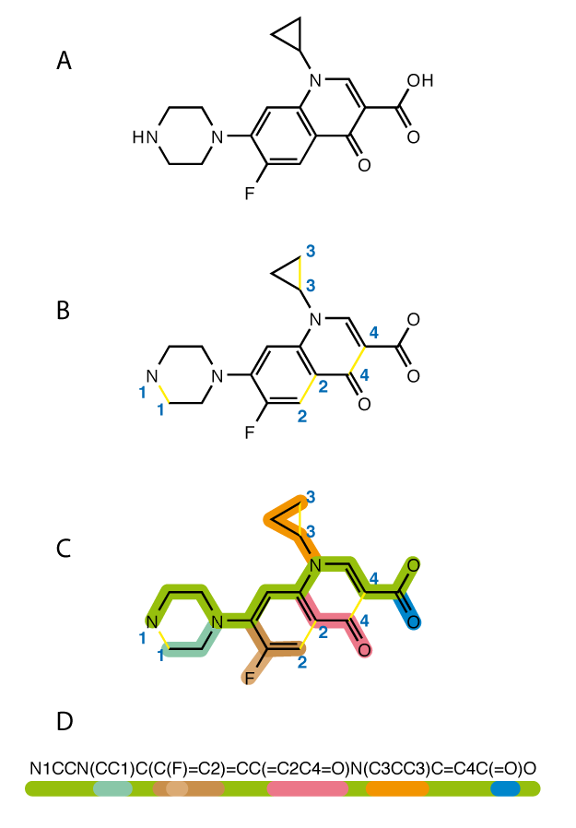
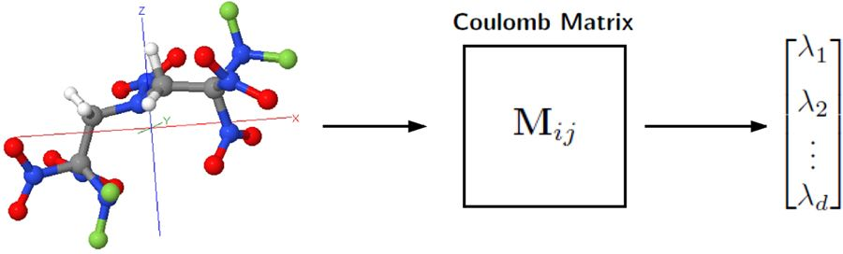
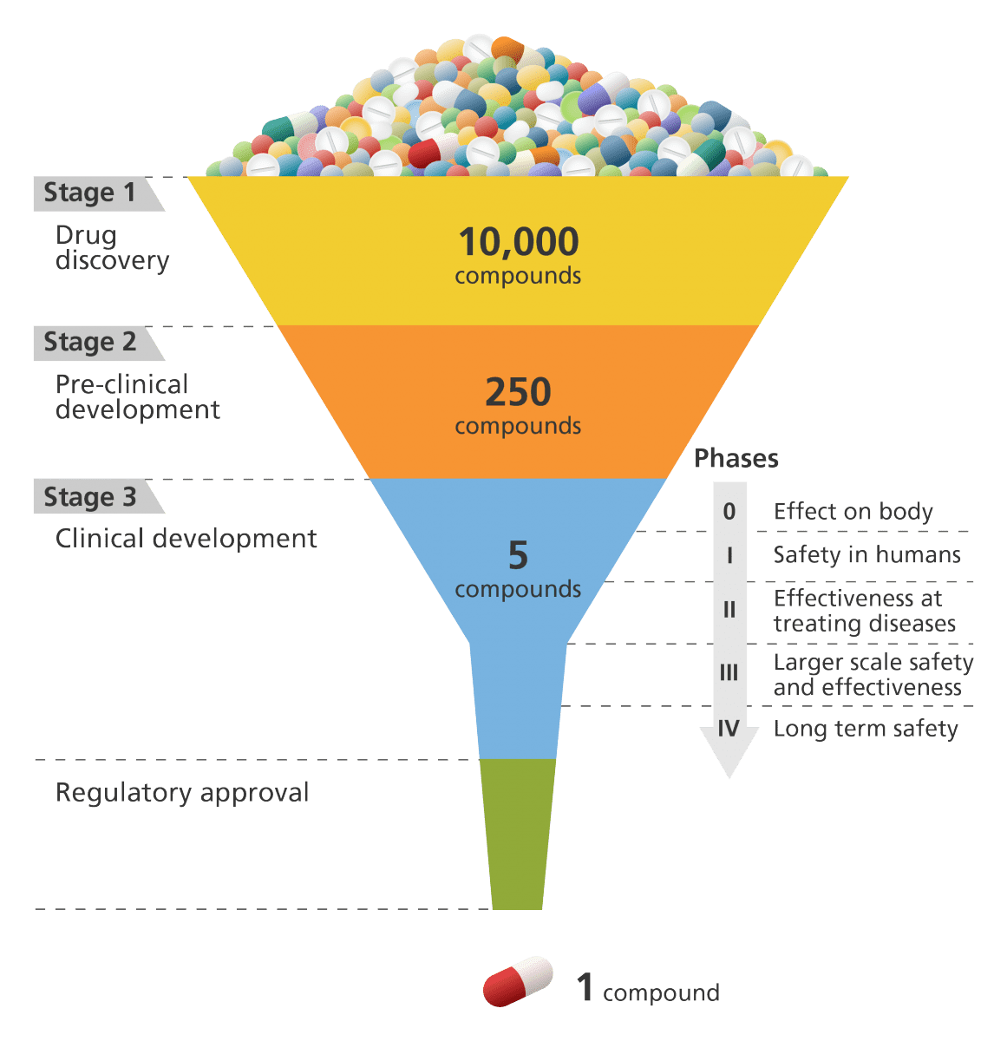



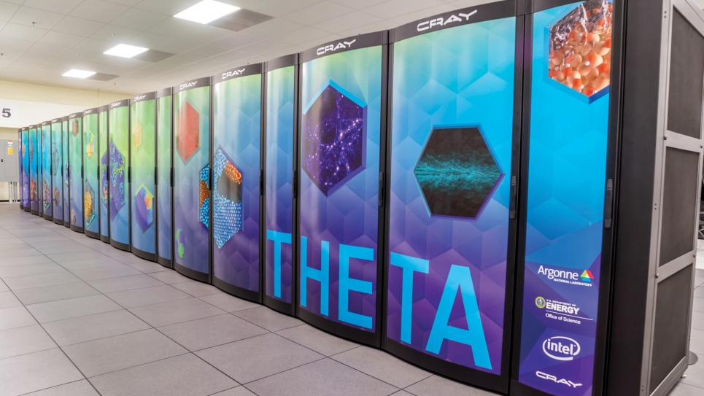

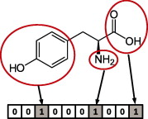
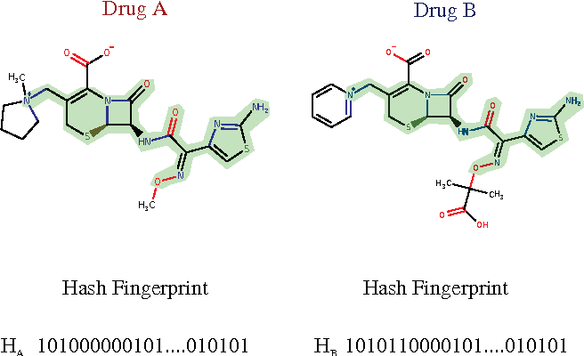


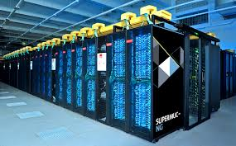


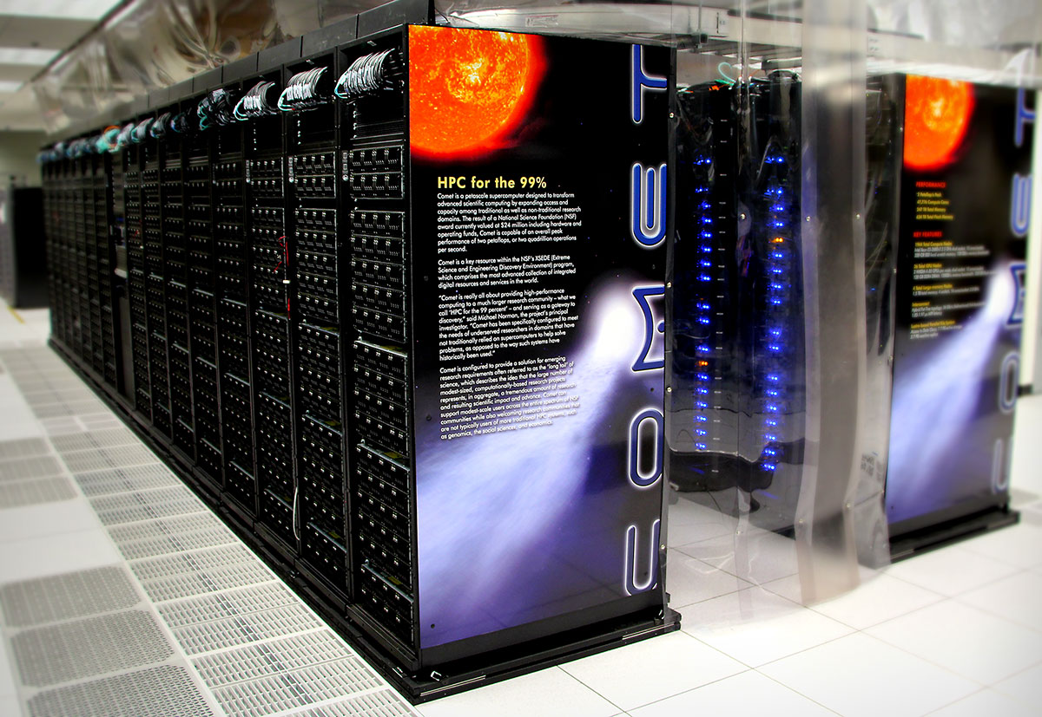

Our HPC- and AI-enabled small molecule filtering pipeline
First release: 21 sources, 3.9B molecules, 80 TB computed features
Computing Resources
Chemical Databases
Canonicalization
Compute Features
ML based filtering
GDB
Fingerprinting
Similarity Search
cureFFI
MOSES
ZINC15
Generate Images
DNN filtering
And more…
https://2019-ncovgroup.github.io
Notes:
Let me give you some more the details about one project that I have been working in the last month. We know covid-19 now impacts the world seriously. So we have a big group of researchers who are trying to find drug candidates that can potentially cure covid19. For some contexts of this project, many viruses rely on a protein to attach to human cells and then use the human cells to make copies of themselves. So one approach to cure virus is to identify the structure of virus and host proteins, and explore what drug structure can be docked to the protein and inhibit it from binding to human cell. So what we want to do is to quickly screen billions of molecules and then use machine learning model to predict a short list of candidates which may inhibit the protein. The short list of candidates then are run through simulation, experiments, and ultimately clinical trials.
So the detailed steps are we have some chemical databases that have billions of molecules, we first use Canonicalization tool to standardize the format, and then compute the features to feed in the machine learning models. Then we use machine learning models to predict a list of drugs that have high score. The results are then feed back to a similarity search loop to enrich the target drugs.
However, the problem here, there are billions of molecules. These steps requir a lot of CPU hours and each step has different runtime characteristics like environments and duration. So no single resource can perfectly run all the tasks concurrently. THe solution here is to use many distributed computers to accelerate the computation. But this will bring new challenges, which are about thedevelopment/management cost on that many distributed computers that have heterogeneous envrionments
So that is the covid 19 example.
The examples I mention so far are mostly for science, however, there are also similar examples in industry
Remove details, doing mass,

Slide 2
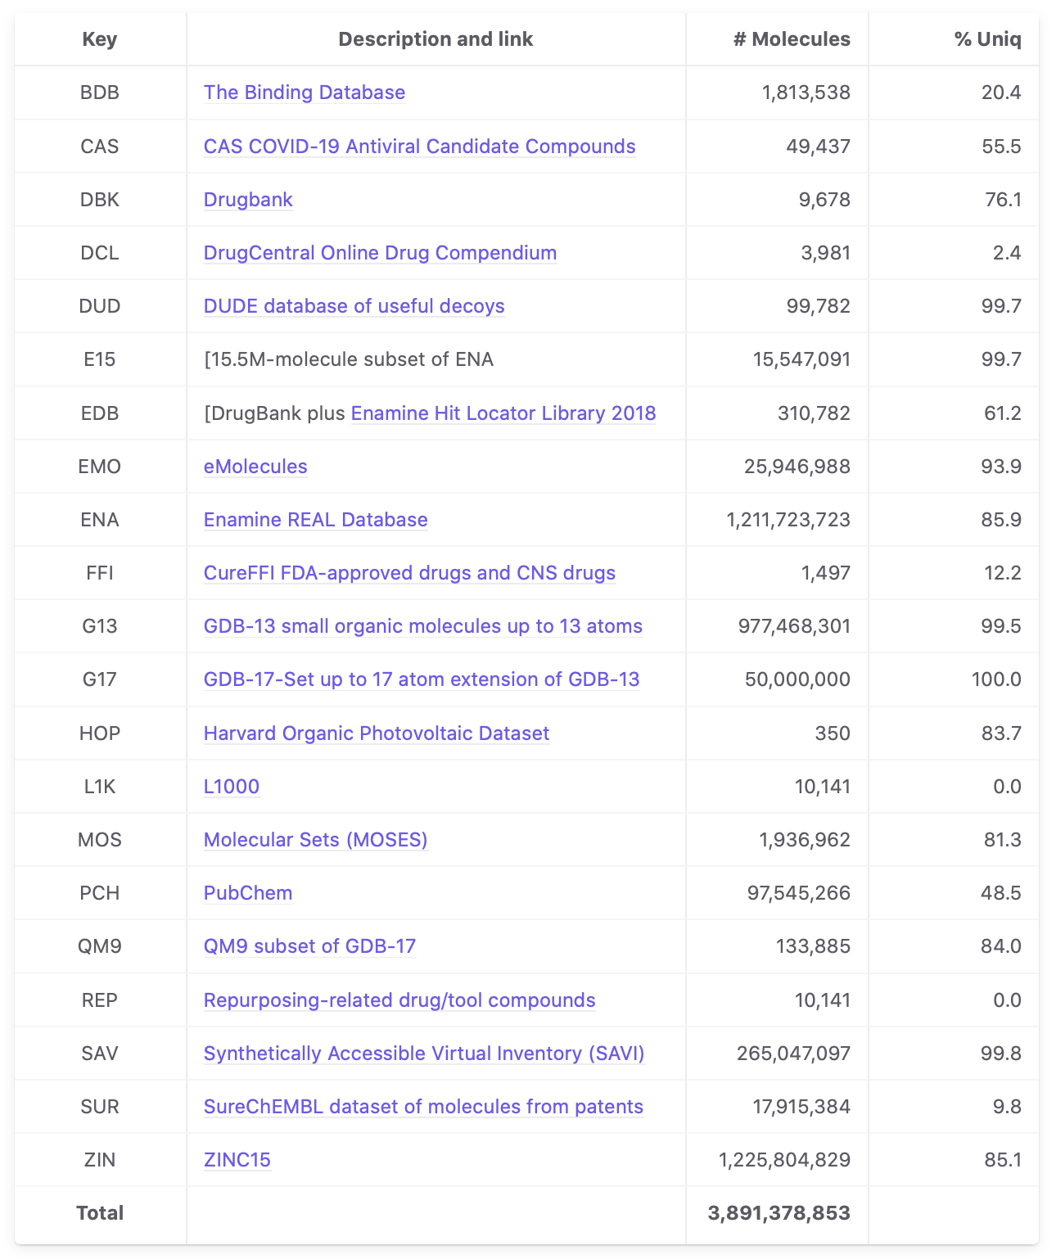
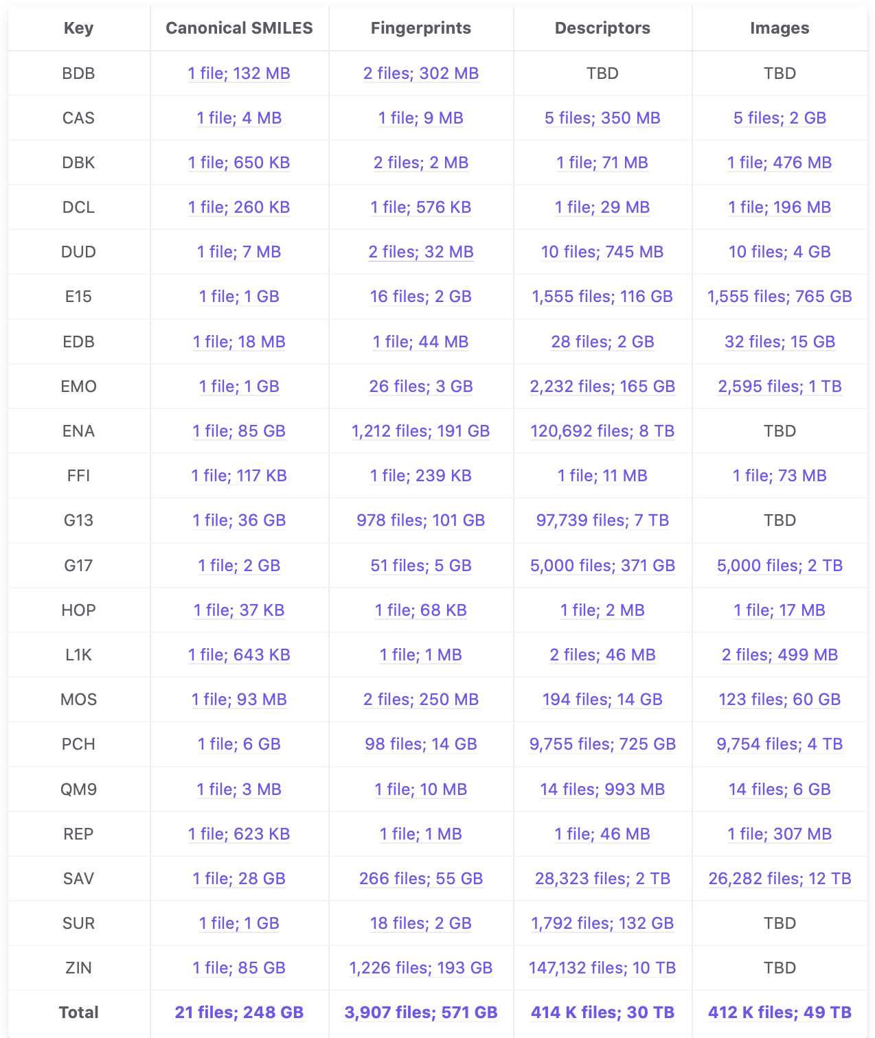
First release: 21 sources, 3.9B molecules, 80 TB computed features
https://2019-ncovgroup.github.io

Slide 3
We build on powerful data and computing tools
Globus
Petrel
Automate
Parsl
RADICAL?

